Slide 1

Final capstone

Slide 2
Things to cover
Original Proposal ◦
Client
Hypotheses
Approach
Results
Key SQL Query Outputs
Correlations
Discussion
Interpretation of Results and Relationships
Metrics Created

Slide 3
Original proposal

Slide 4
Why this client?
Considerable amount of data (over 271,000 rows of data) ◦ Variety of avenues to explore the data (broad topic) ◦ Some examples: ◦ Weight effect on medaling in a sport? ◦ What countries are winning throughout history and trends in this way?

Slide 5

Project Description
This project will focus on the types of athletes that succeed in the Olympics.
Specifically, this project will look at the whether height and weight play a role for an athlete’s success, as a general principle.
A personal trainer could use this to determine, based on the event (and from this, the season) to influence how to adapt someone’s body to succeed.
The general public could also make conclusions from viewing these results, about the best body type for their health and fitness goals. 5. The primary audience will be anyone seeking to make physiological adaptions, to themselves or others.

Slide 6
Hypothesis
Higher weight and height will lead to more successes through medals in the Olympics

Slide 7
Approach
The first step is looking generally at whether any trend exists at all. This means examining the height, weight, and medals columns primarily. ◦ Whether or not one does, then breaking this down by different groups (mentioned in the last slide) will provide a clearer view of the impact ◦ Next, determining in these same groups if the trend is actually influenced by the ratio, or whether height or weight alone is the more important factor ◦ I predict that not all events/seasons/ages/genders will produce an effect, but especially for certain events, I perceive that there will be certain ones that predispose certain body types to success

Slide 8

Results

Slide 9
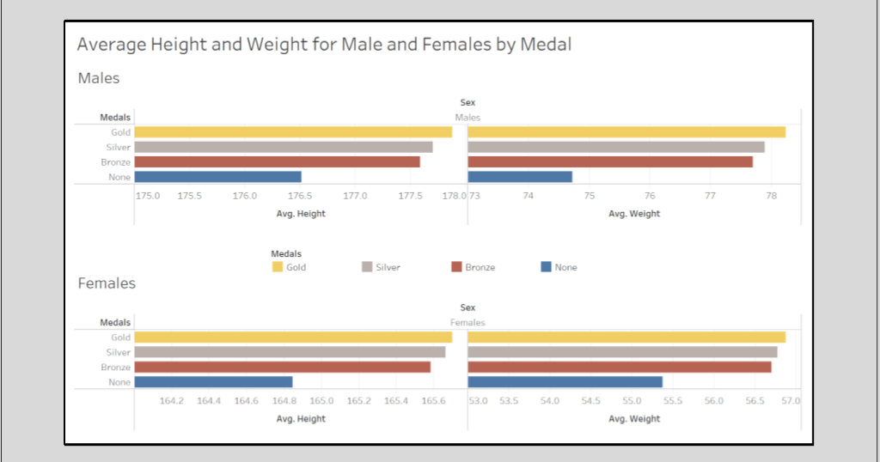

Slide 10
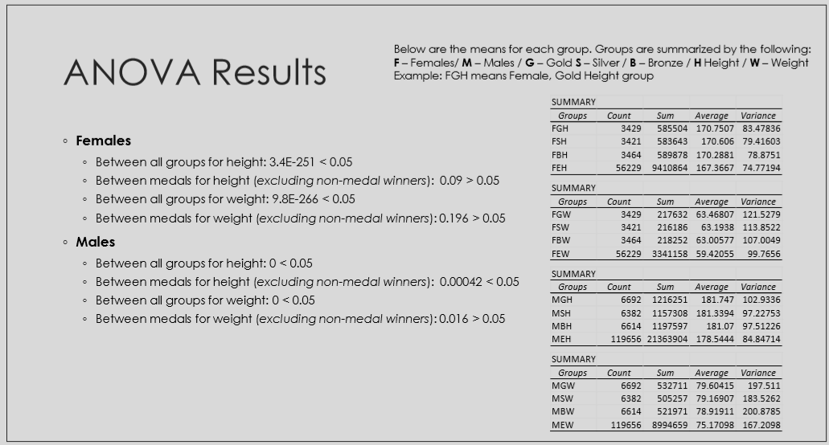

Slide 11
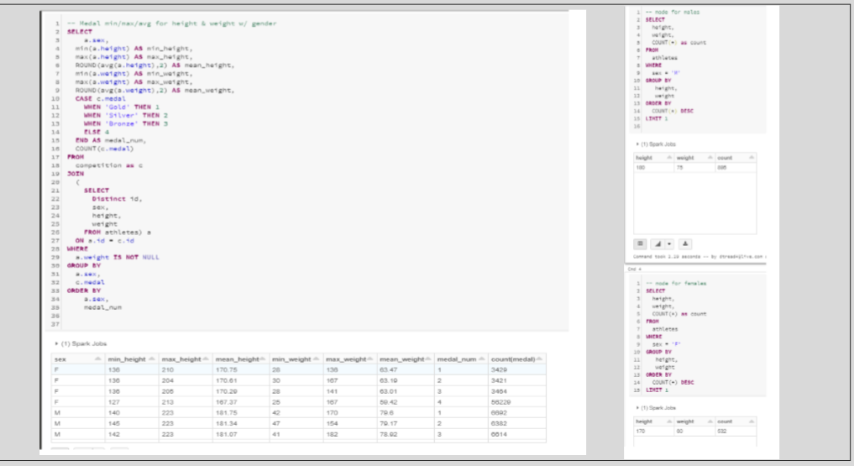

Slide 12
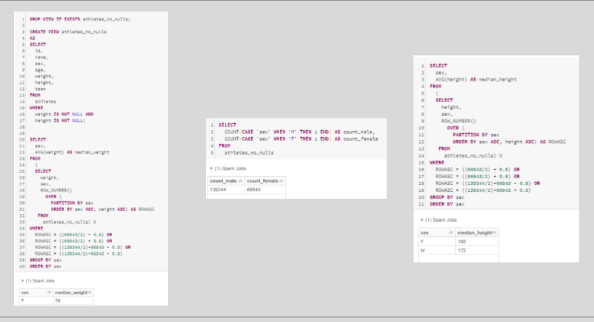

Slide 13
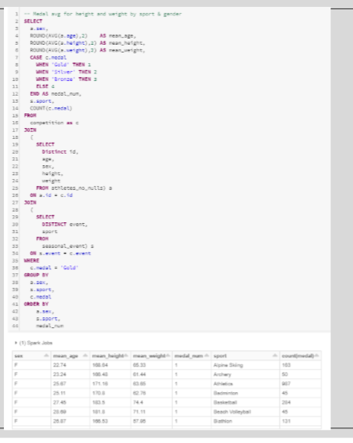

Slide 14
Discussion

Slide 15
Interpreting Results and Relationships
From the ANOVA, we can see that for females, there is a significant difference between the group means for height and weight, when comparing medalists to non-medalists, but not comparing between medals. This means that height and weight have a relationship with a female gets to the podium but tells us nothing about what medal they might have received.
For men, the ANOVA shows us that there is a significant difference between groups at all levels, which means that there is a linear relationship between an athlete’s height or weight, and how they will place (e.g. higher weight/ height, higher medal).
While these results are interesting, we must keep in mind how small these differences truly are. The differences between groups are only a few centimeters/kilograms. It is still interesting that on average, there is a small difference though.
While height cannot be changed, an athlete can see that increasing their weight (which will come from increasing muscle mass, not fat mass) can have a positive effect on performance, especially for men.
Age did not have any significant impact on success

Slide 16
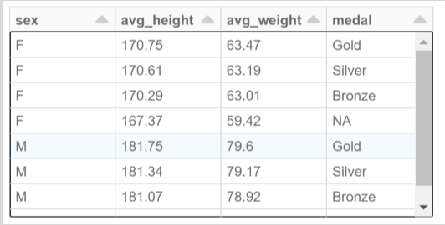
Metrics Created
◦ Metric 1: Expected height of sport's medalists. I created this so one can compare themselves to the average height (in the normal distribution range of +/- 45% of the median) of the various medal levels in a sport. ◦ Metric 2: Expected weight of sport's medalists. I created this so one can compare themselves to the average weight (in the distribution range of +/-45% of the median) of the various medal levels in a sport.

